Slide 1
Application of homogeneous linear equation with constant coefficient
Presented by: Sayel Ahmed
Id: 2021-1-60-025
Course Instructor: Dr. Akter Hossain
Course Code: Mat102
Section : 05

Slide 2
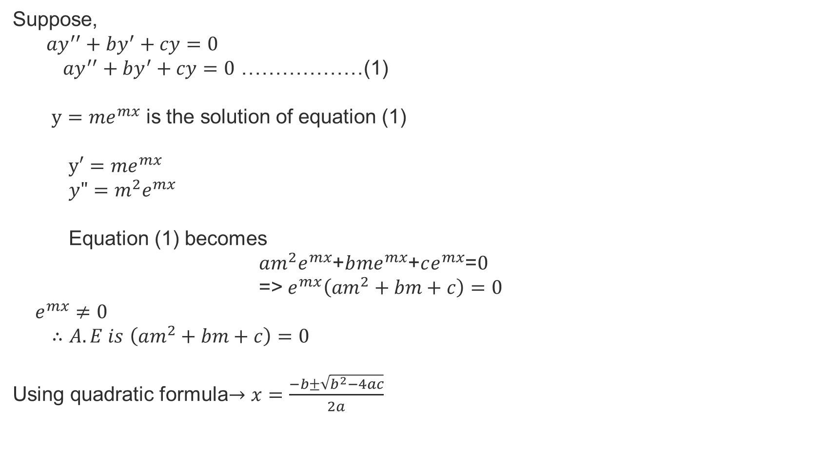
Suppose,
${ay}^{′′}+{by}^{′}+cy=0$
${ay}^{′′}+{by}^{′}+cy=0$ ………………(1)
$y={me}^{mx}$ is the solution of equation (1)
$y′={me}^{mx}$
$y"=m^{2}e^{mx}$
Equation (1) becomes
$am^{2}e^{mx}$+$b{me}^{mx}$+$ce^{mx}$=$0$
=> $e^{mx}\left(am^{2}+bm+c\right)=0$
$e^{mx}≠0$
$∴A.E is$ $\left(am^{2}+bm+c\right)=0$
Using quadratic formula$→x=\frac{−b±\sqrt{b^{2}−4ac}}{2a}$

Slide 3
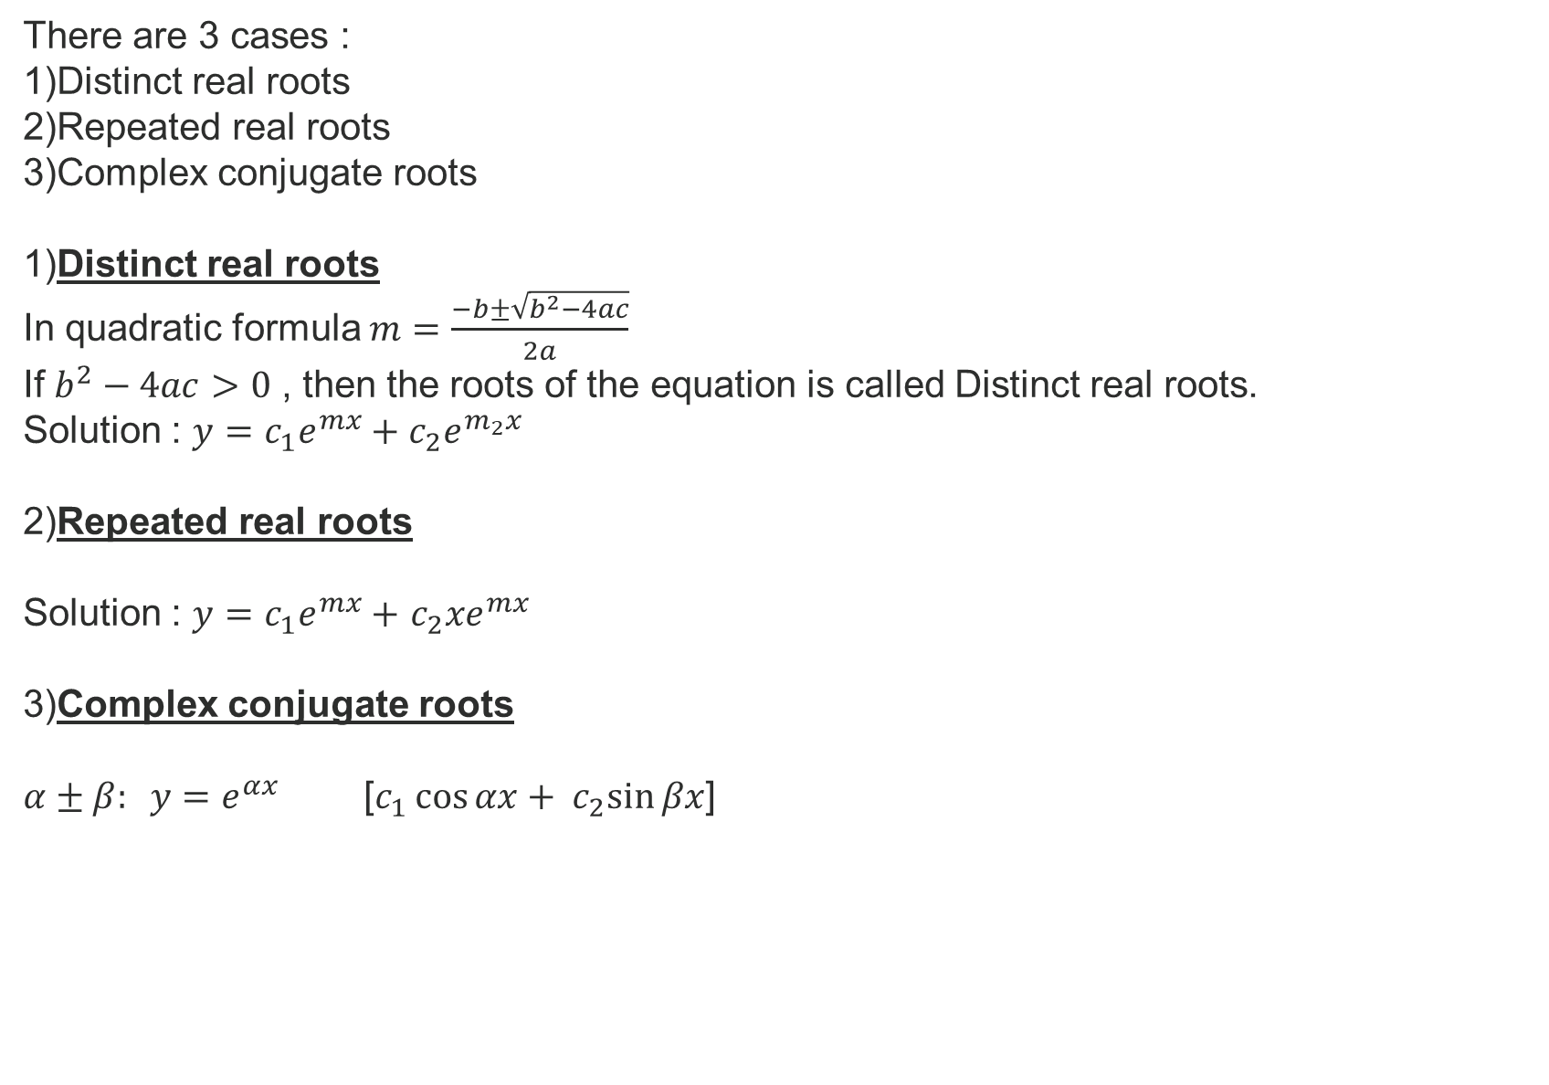
There are 3 cases :
1)Distinct real roots
2)Repeated real roots
3)Complex conjugate roots
1)Distinct real roots
In quadratic formula $m=\frac{−b±\sqrt{b^{2}−4ac}}{2a}$
If $b^{2}−4ac>0$ , then the roots of the equation is called Distinct real roots.
Solution : $y=c_{1}e^{mx}+c_{2}e^{m_{2}x}$
2)Repeated real roots
Solution : $y=c_{1}e^{mx}+$ $c_{2}{xe}^{mx}$
3)Complex conjugate roots
$α±β: y=e^{αx}$ [$c_{1}\cos{αx}+ c_{2}sin{βx}$]

Slide 4
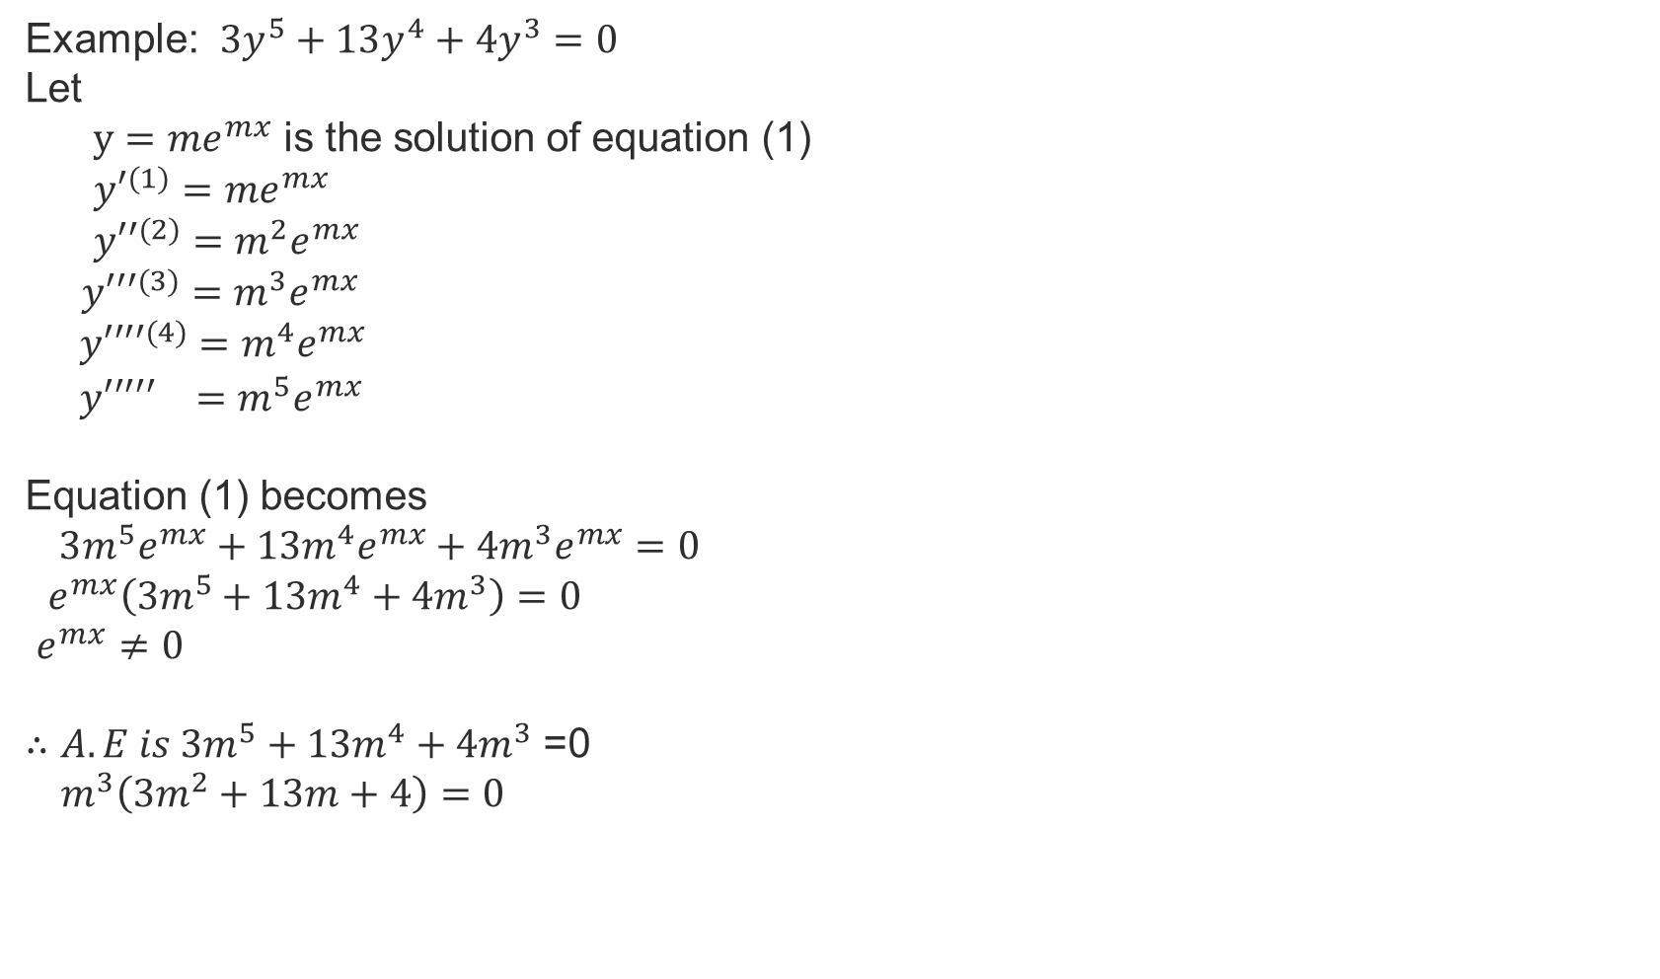
Example: $3y^{5}+13y^{4}+4y^{3}=0$
Let
$y={me}^{mx}$ is the solution of equation (1)
${y′}^{(1)}={me}^{mx}$
${y′′}^{(2)}=m^{2}e^{mx}$
${y′′′}^{(3)}$ $=m^{3}e^{mx}$
${y′′′′}^{(4)}$ $=m^{4}e^{mx}$
${ y′′′′′}^{}$ $=m^{5}e^{mx}$
Equation (1) becomes
$3m^{5}e^{mx}+13m^{4}e^{mx}+4m^{3}e^{mx}=0$
$e^{mx}\left(3m^{5}+13m^{4}+4m^{3}\right)=0$
$e^{mx}≠0$
$∴A.E is 3m^{5}+13m^{4}+4m^{3}$ =0
${ m}^{3}\left(3m^{2}+13m+4\right)=0$

Slide 5
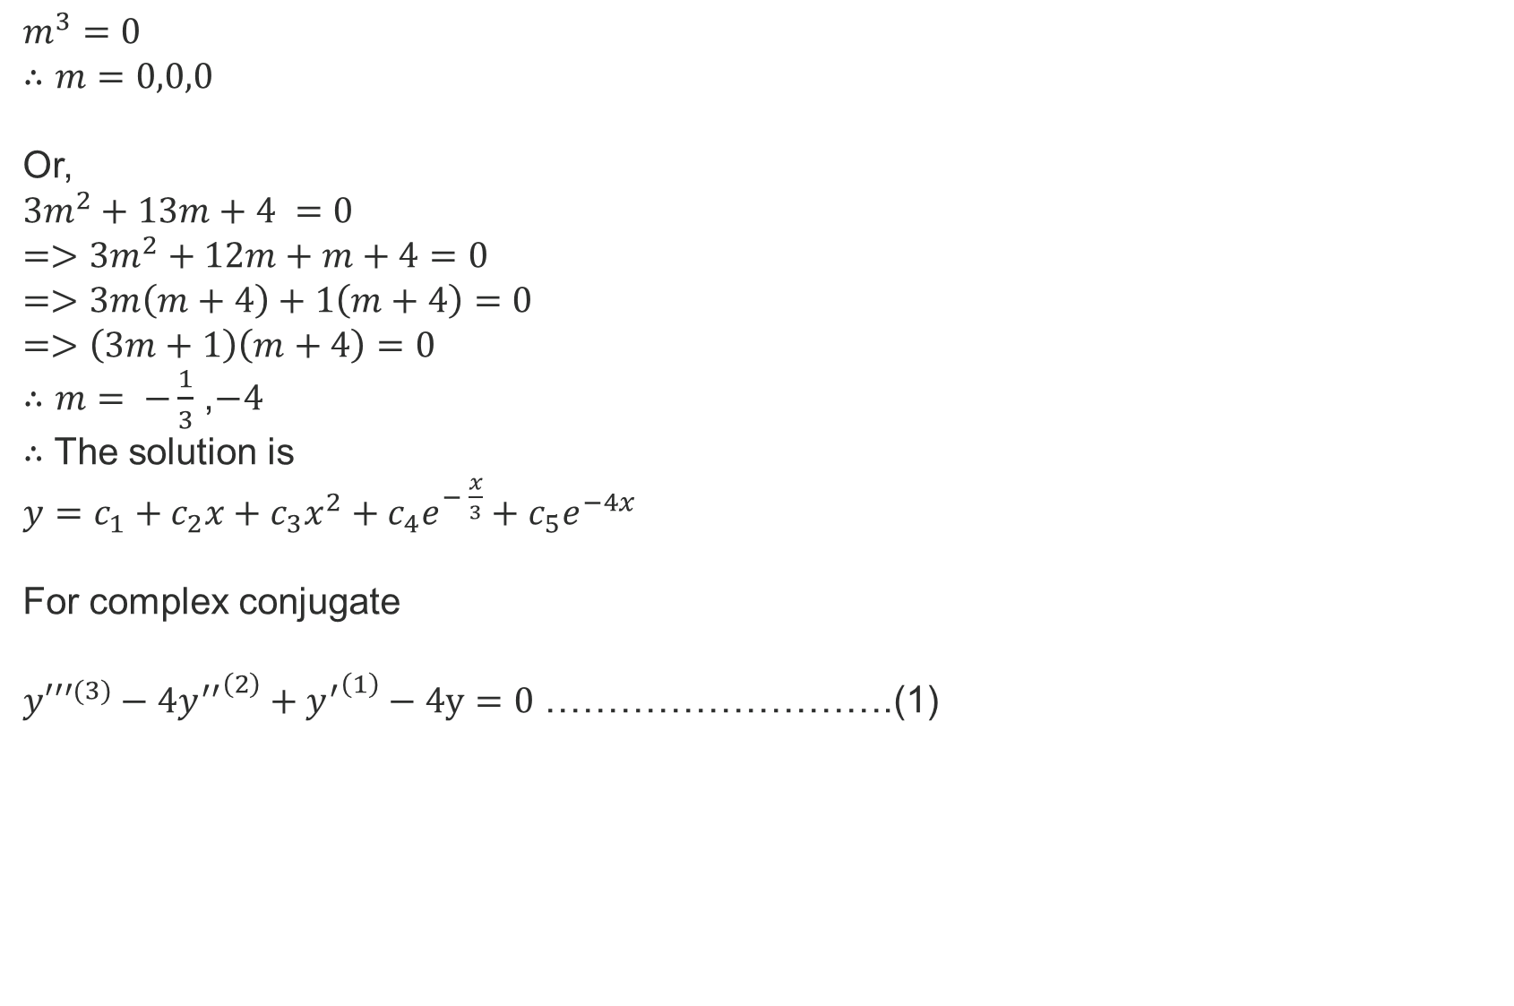
$m^{3}=0$
$∴m=0,0,0$
Or,
$3m^{2}+13m+4 =0$
$=>3m^{2}+12m+m+4=0$
$=>3m\left(m+4\right)+1\left(m+4\right)=0$
$=>\left(3m+1\right)\left(m+4\right)=0$
$∴m= −\frac{1}{3}$ ,$−4$
$∴$ The solution is
$y=c_{1}+c_{2}x+c_{3}x^{2}+c_{4}e^{− \frac{x}{3}}+c_{5}e^{−4x}$
For complex conjugate
${y′′′}^{(3)}−4{y^{′′}}^{\left(2\right)}+{y^{′}}^{\left(1\right)}−4y=0$ ……………………….(1)

Slide 6
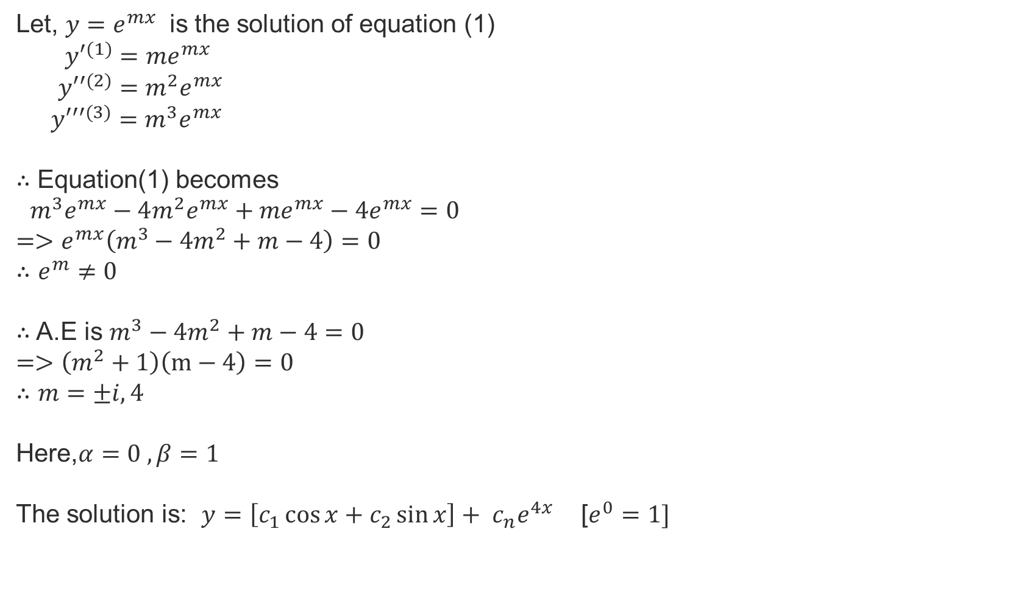
Let, $y=e^{mx}$ is the solution of equation (1)
${y′}^{(1)}={me}^{mx}$
${y′′}^{(2)}=m^{2}e^{mx}$
${y′′′}^{(3)}$ $=m^{3}e^{mx}$
$∴$ Equation(1) becomes
$m^{3}e^{mx}−4m^{2}e^{mx}+{me}^{mx}−{4e}^{mx}=0$
$=>e^{mx}\left(m^{3}−{4m}^{2}+m−4\right)=0$
$∴e^{m}≠0$
$∴$A.E is $m^{3}−{4m}^{2}+m−4=0$
$=>\left(m^{2}+1\right)\left(m−4\right)=0$
$∴m=±i,4$
Here,$α=0 ,β=1$
The solution is: $y=\left[c_{1}\cos{x}+c_{2}\sin{x}\right]+ c_{n}e^{4x}$ [$e^{0}=1]$

Slide 7
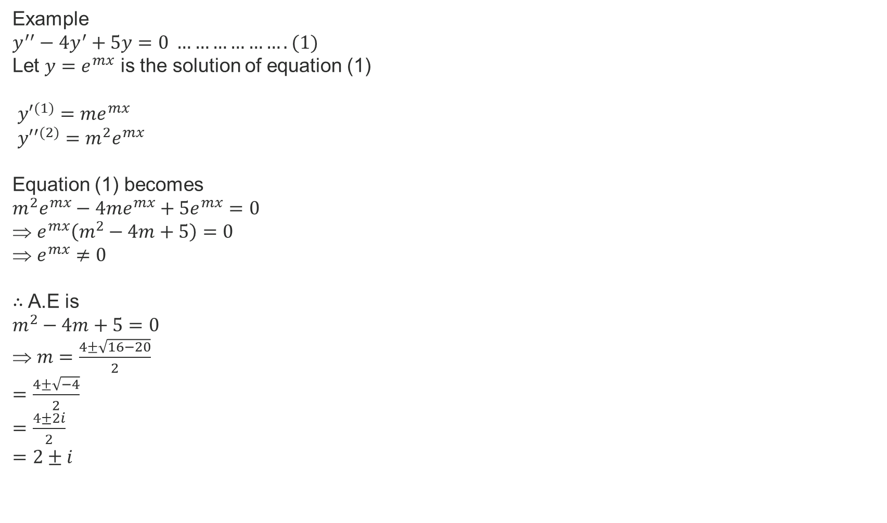
Example
$y^{′′}−4y^{′}+5y=0 ……………….(1)$
Let $y=e^{mx}$ is the solution of equation (1)
${y′}^{(1)}={me}^{mx}$
${y′′}^{(2)}=m^{2}e^{mx}$
Equation (1) becomes
$m^{2}e^{mx}−4{me}^{mx}+5e^{mx}=0$
$e^{mx}\left(m^{2}−4m+5\right)=0$
$e^{mx}≠0$
$∴$ A.E is
$m^{2}−4m+5=0$
$m=\frac{4±\sqrt{16−20}}{2}$
$=\frac{4±\sqrt{−4}}{2}$
$=\frac{4±2i}{2}$
$=2±i$

Slide 8
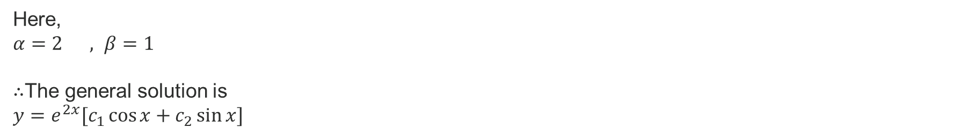
Here,
$α=2 , β=1$
$∴$The general solution is
$y=e^{2x}[c_{1}\cos{x}+c_{2}\sin{x}]$

Slide 9
Thank You

